Slide 1
GTU CSE495 Smart Mobile Application for Identification and Tracking Packaging in Recycling
CSE495
Second Presentation
Emre Güven
Project Advisor: Prof. Dr. Yusuf Sinan AKGÜL
December 2023

Slide 2
Contents
Schema and Description of The Project
What has been done so far?
Object Detection Model | Test Dataset Results
Object Detection Model | Application Test Results
Video Classification Model | Best Test Result
Improvements to be made for done parts
What will be done?
Project Timeline
Success Criteria
References

Slide 3
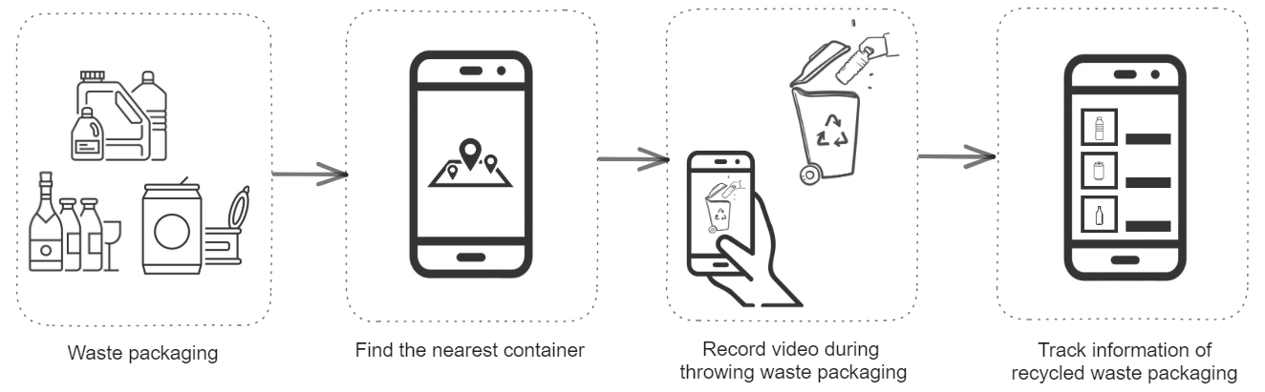
Schema and Description of The Project
A mobile application that can recognize the recyclable waste packaging materials and the action of throwing materials into the recycling container.
Users are able to track information about the waste packaging they have previously thrown into recycling containers.

Slide 4
What has been done so far?
Labelled 2500 images of packaging and containers, for object detection model, with 19 label classes.
Trained object detection model with labelled images.
Object detection model is integrated to run on mobile application.
Prepared short videos of throwing waste action and no throwing waste action for video classification model.
300 videos for throwing waste action
130 videos for no throwing waste action
Created video classification model and trained with 260 videos(130 videos for each class).
Collected locations of some containers in Gebze, Çayırova and Darıca.

Slide 5
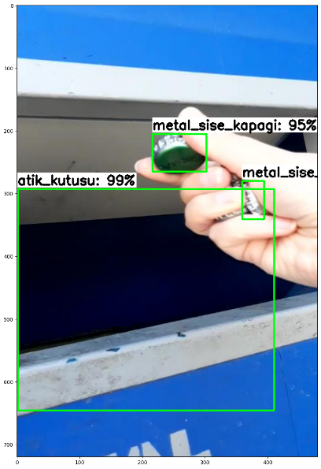
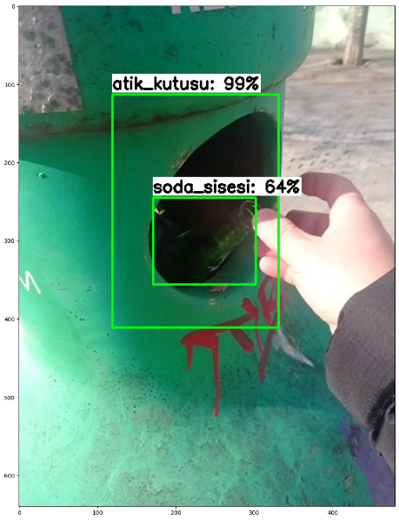
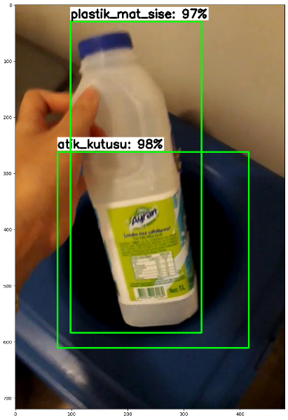
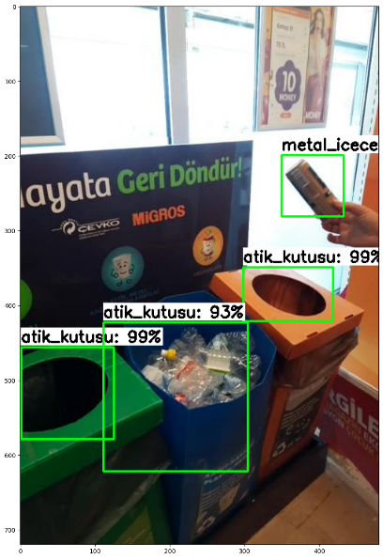
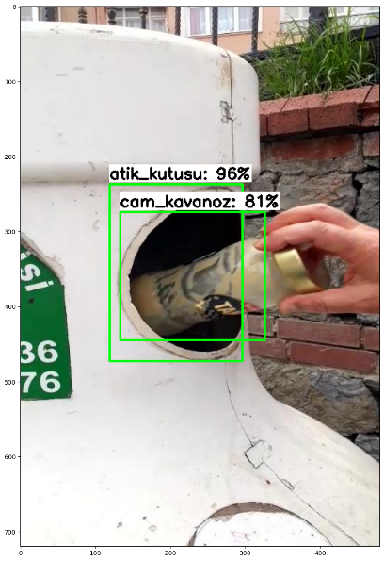
What has been done so far?
Object Detection Model | Test Dataset Results

Slide 6
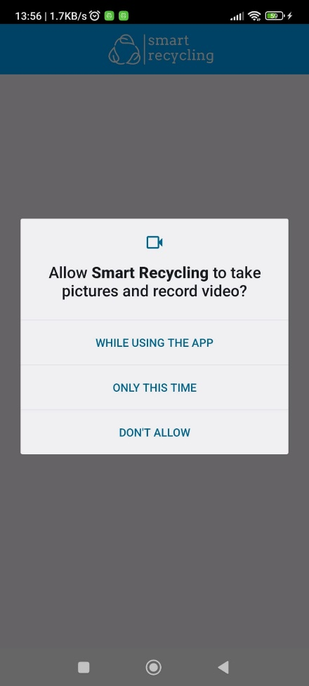
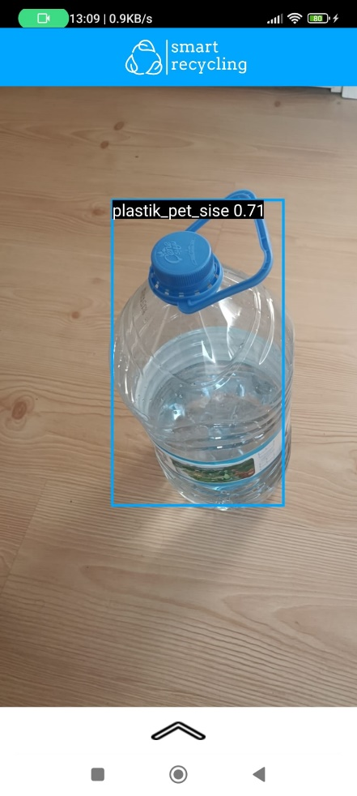
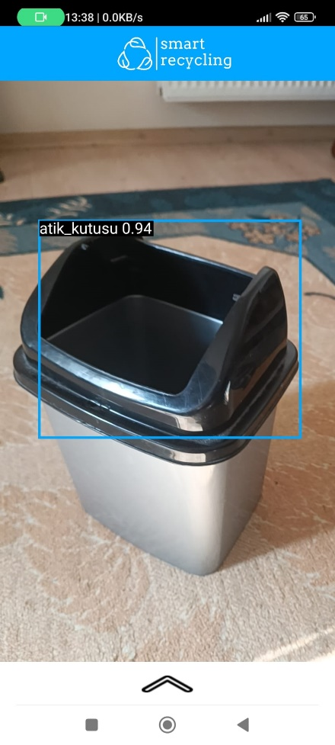
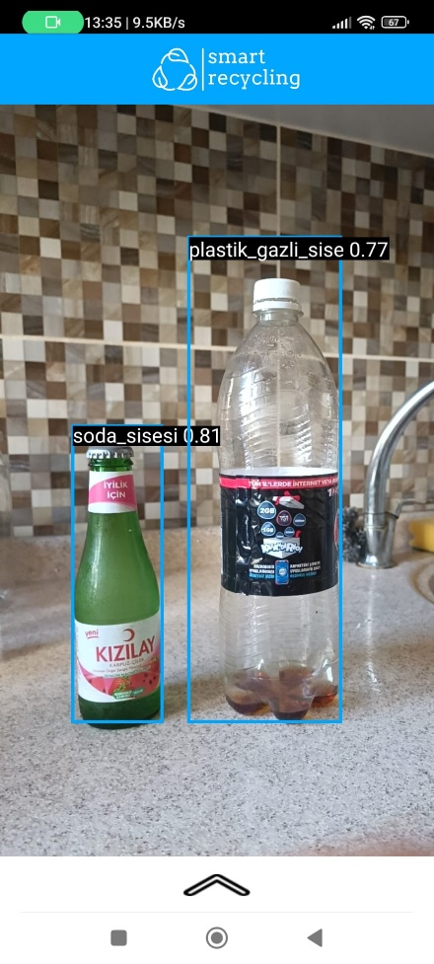
What has been done so far?
Object Detection Model | Application Test Results

Slide 7
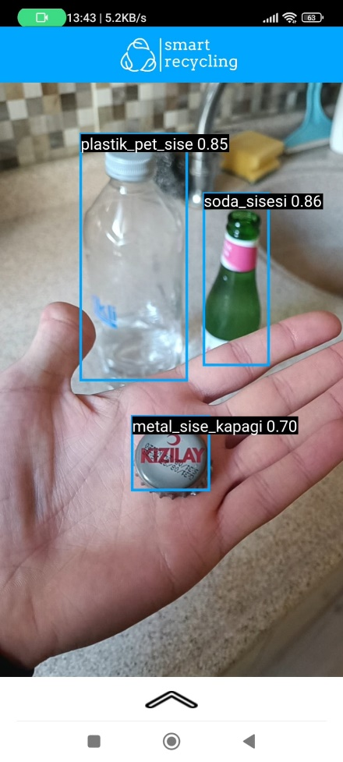
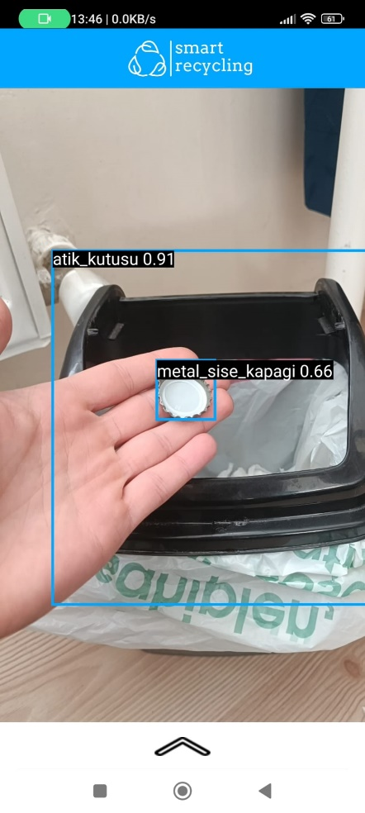
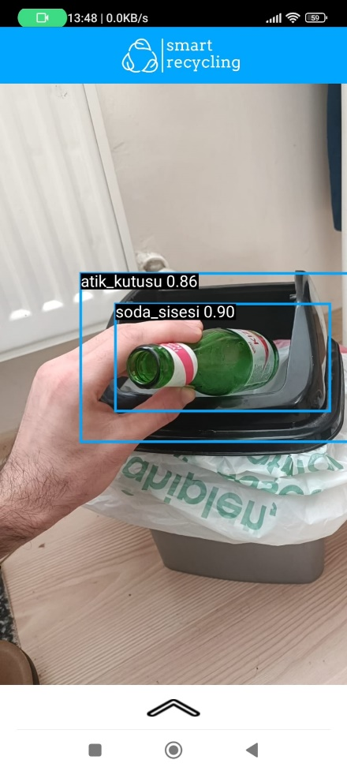
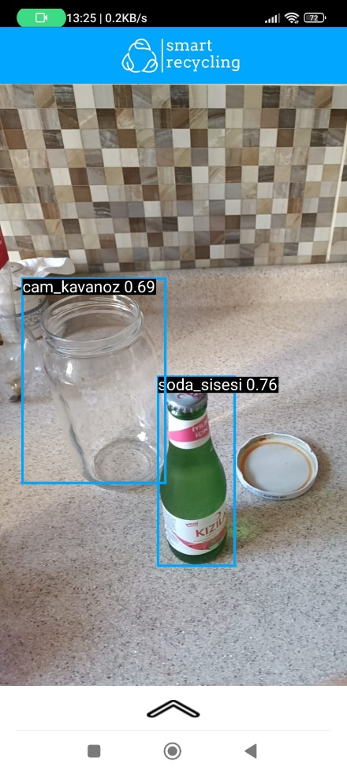
What has been done so far?
Object Detection Model | Application Test Results

Slide 8
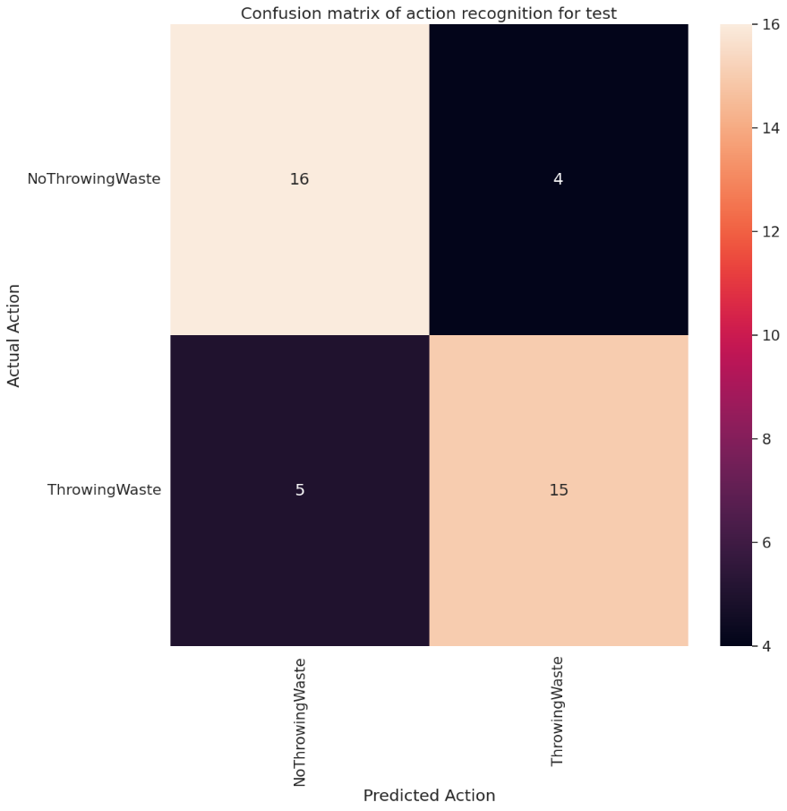
What has been done so far?
Video Classification Model | Best Test Result
Training configuration:
Data splitting for each class:
Train data = 95
Validation data = 15
Test data = 20
Batch size = 8
Epoch = 50
Learning rate: 0.001
Precision Results:
'NoThrowingWaste’ : 0.7619047
'ThrowingWaste’ : 0.7894736

Slide 9
Improvements to be made for done parts
For improving datasets:
Should be add and labeled at least 100 images to each class that has relatively fewer images than the others(half of classes).
Should be add at least 150 no throwing waste action videos.
Should be collected locations of containers in university campus.

Slide 10
What will be done?
Retraining models with improved datasets.
Integration of video classification model to the mobile application.
Designing UI and implementing functionalities for other screens.
Integrations of models and tests.

Slide 11
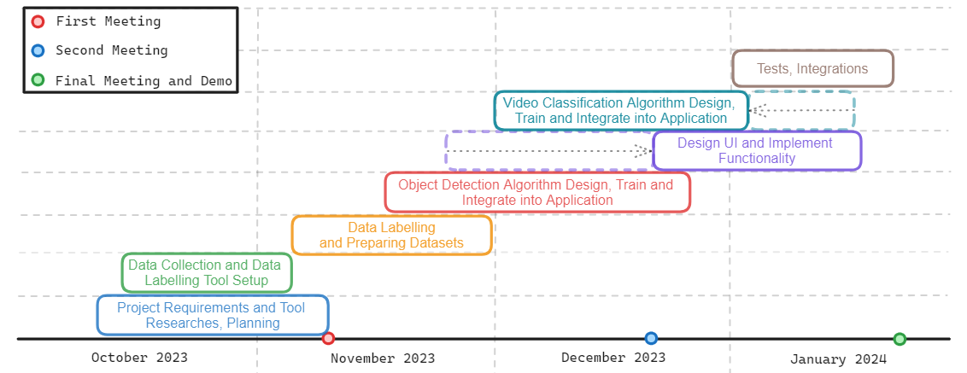
Project Timeline

Slide 12
Success Criteria
The type and the quantity of waste packaging materials should be detected with at least 80% accuracy.
Containers should be detected with at least 90% accuracy.
At least 5 frame per second should be received and processed. Result should be shown to the user at most 10 seconds.

Slide 13
References
https://www.tensorflow.org/lite/android
https://www.tensorflow.org/lite/android/tutorials/object_detection
https://www.tensorflow.org/lite/models/convert/metadata
https://www.tensorflow.org/tutorials/video/video_classification
https://www.tensorflow.org/tutorials/load_data/video
https://www.biriktir.app/
https://labelstud.io/
https://veri.kocaeli.bel.tr/dataset/mobil-atik-getirme-merkezleri

